Slide 1
A study of the Fermi bubbles near the Galactic plane
Dmitry Malyshev,
Laura Herold
Fermi LAT diffuse meeting
August 15, 2017

Slide 2
General information about the project
People involved:
Dima Malyshev, Laura Herold
Category of project: II
Follow up work on the bubbles
Some results on the bubbles at low latitudes were already published in:
the Fermi LAT diffuse paper (arxiv:1602.07246)
the pass 8 GC analysis paper (arxiv:1704.03910)

Slide 3
Motivation
Origin of the Fermi bubbles
AGN-like emission from Sgr A*
Bubbles are expected to have an hour-glass shape centered at the GC
Starburst / star formation
Bubbles don’t need to be centered at the GC

Slide 4
Properties of the bubbles at high latitudes
Fermi LAT bubbles analysis paper (arxiv:1407.7905)
Bubbles at latitudes |b| > 10 deg
Homogeneous spectrum with a cutoff around 100 GeV
Homogeneous intensity + cocoon

Slide 5
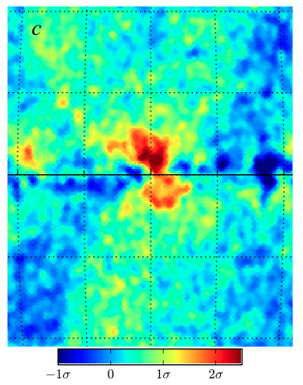
Previous analysis near the Galactic plane
Hints of a different behavior near the Galactic center
No cutoff at high energies
Higher intensity near the GC
Displaced from the GC to the right (negative longitudes)
Fermi LAT diffuse model
Acero et al (2016) arxiv:1602.07246
Pass 8 GC analysis Ackermann et al (2017)
arxiv:1704.03910

Slide 6
Goals of the new analysis
Test the features of the Fermi bubbles near the Galactic plane:
Larger intensity than at high latitudes
Emission displaced to the right from the GC
Spectrum without a cutoff around 100 GeV
Usually there are many assumptions made in the analysis -> hard to argue that the features are in the data and not an artifact of the analysis
We will start with very simple empirical models of the foreground emission (such as using low energy data to model the foreground at high energies) and increase the complexity from one model to another
At the end we compare the simple empirical models with a GALPROP model

Slide 7
This analysis
Data selection:
Pass 8 Source class (relatively small area)
8 years (August 4, 2008 - August 3, 2016)
Energies between 300 MeV – 1 TeV in 24 logarithmic energy bins
HEALPix pixelation order 7 (resolution 0.5°)
Analysis strategy:
Asymmetry in the data
Low-energy Fermi data as a template of foreground emission
Template of the bubbles modelled by “boxes” + low-energy-data template
GALPROP + isotropic, bubbles, Loop I, etc. + point-source refitting model

Slide 8
The low-energy model
Fit the data in energy bins between 1.6 GeV and 1 TeV in 4° latitude stripes by a combination of two templates:
Low-energy Fermi data (600 MeV – 1.6 GeV): N_{low} → spatial template of the foreground (IC + π⁰) that has a softer spectrum than the bubbles
Isotropic (in a latitude stripe) component: c
Region of bubbles is excluded (-20° < l < 20°)
200 brightest point sources are masked

Slide 9
Low-energy model residuals

Slide 10
The boxes model
Components:
As before: N_{low}, c
Rectangles covering the Fermi bubbles (divided in east and west): b_{e}, b_{w}
Normalization coefficients N_{low}, c, b_{e}, and b_{w} are fitted to higher-energy data in 4° latitude stripes
Point sources are masked

Slide 11
GALPROP model + PS refitting
Same analysis as in the Pass 8 GC excess study (Sample model)
Templates:
Gas correlated (π⁰ and brems) in 5 rings
IC in 3 components corresponding to IR, starlight, CMB
Geometric Loop I, Sun, Moon, Isotropic
Bubbles at |b| > 10 deg
GC excess (gNFW template)
3FGL point source + refit 40 brightest within R = 10º
Mask 200 brightest PS outside R = 10º
Fit independently in energy bins up to 600 GeV

Slide 12
GALPROP residuals
Residual + bubbles + GC excess:

Slide 13
Latitude profiles
Longitude profiles east and west of GC (-10° < l < 10°)
Models agree well (on southern hemisphere)
Northern hemisphere: large amount of gas-correlated emission
Left-right asymmetry in the models
Boxes model as baseline model?

Slide 14
Spectra in the Galactic plane
Spectra east and west of GC (-10° < l < 10°)
Difference of data: west – east > 0
Left-right asymmetry in models: harder spectrum west of GC

Slide 15
Conclusions
In the analysis we confirm that
the intensity of emission from the bubbles is larger in the Galactic plane;
the spectrum does not seem to have a cutoff at around 100 GeV;
the emission seems to be shifted to the right from the GC.
14

Slide 16
Timeline
September:
Finish analysis
physics interpretation:
fit IC and π⁰ spectra,
particle lifetimes,
total energy output in terms of SNe
October:
Present more results
Work on the draft
15

Slide 17
Spectra slightly above the Galactic plane

Slide 18
Spectra slightly below the Galactic plane

